Slide 1
You mean to tell me…
….you don’t know what CAS is?

Slide 2
What is CAS?
Survey says….
…who you are determines what CAS will be!

Slide 3
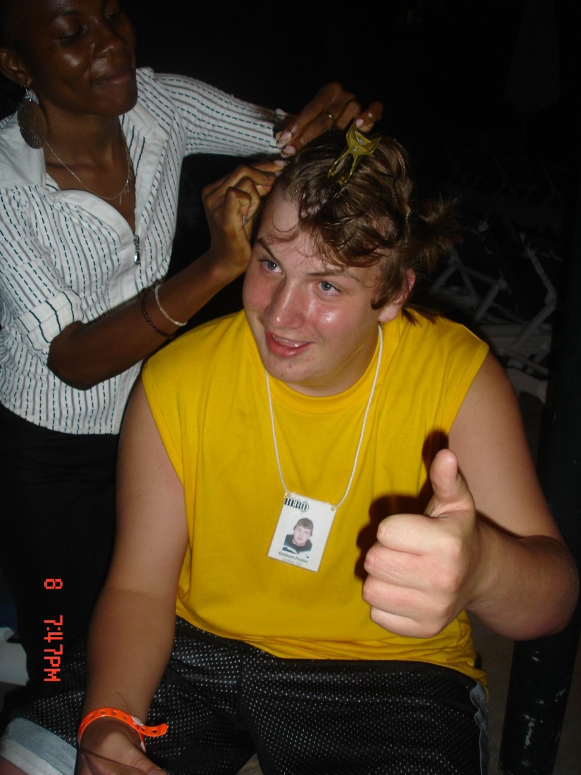
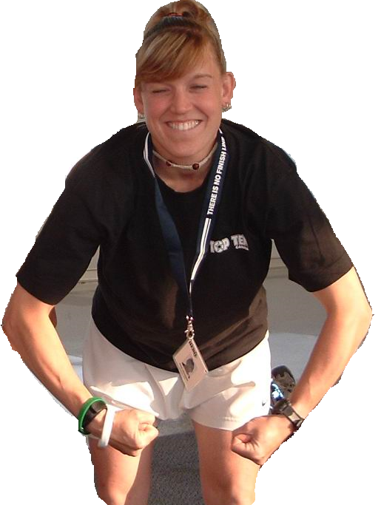
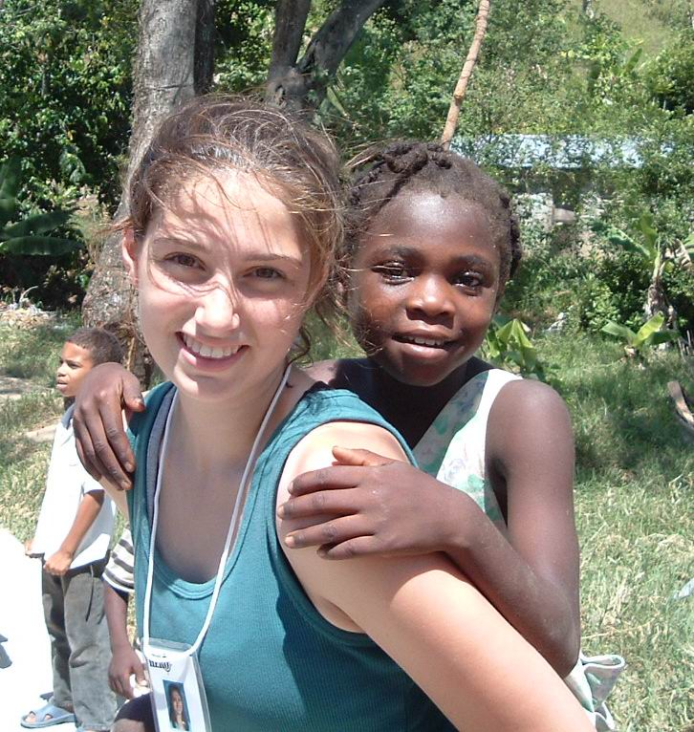
Find your passion and explore new experiences…
Awaken the inner you….
What do you mean You’re not done CAS?
Challenge yourself…
(unless that person is an axe murder!)

Slide 4
What is CAS?
THE PURPOSE OF CAS…
…to learn about who you are by experiencing life!
Notes:
CAS is a program designed to encourage students to learn through experiences involving roles that are NEW to them. Reflection on these experiences is a critical component that allows the student to truly reap the maximum benefits they have put forth during their CAS experience.

Slide 5
Nature of CAS…
For student development to occur, CAS activities need to involve:
• Real, purposeful activities, with significant outcomes
• Personal challenge!
• Planning, reviewing progress and reporting.
• Reflection

Slide 6
Learning outcomes…
These 8 learning outcomes are the backbone of the CAS experience:
1. Increased awareness of personal strengths and areas for growth
2. Undertaken new challenges
3. Planned and initiated activities
4.Worked collaboratively with others
5. Shown perseverance and commitment in their activities
6. Engaged with issues of global importance
7. Considered the ethical implications of their actions
8. Developed new skills

Slide 7
Creativity
Creativity wears many coats!
Notes:
This element is designed to cover a wide range of arts and other activities, (preferably in groups) such as dance, theatre, design, photography, music, and visual arts. It can include the creative aspect of designing and carrying out service projects.

Slide 8
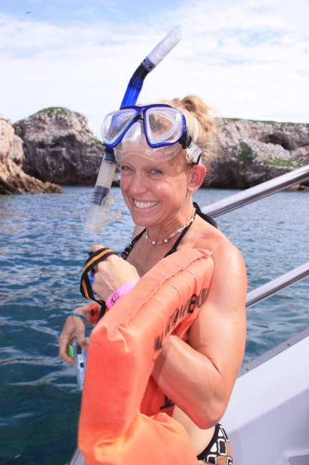
Action
Notes:
We all need physical activity but can get it in many different ways. Sports, camping, belly-dancing, yoga – hey, get out there and connect with your elderly neighbour that you have yet to speak with. Walk his dog that you’ve been secretly afraid of all this time!

Slide 9
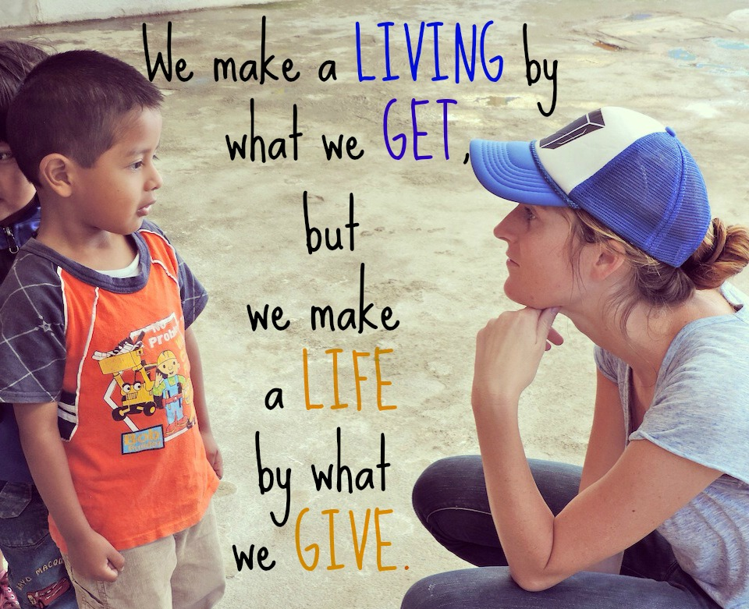
Service
Giving of yourself is one of the greatest gifts you have to offer. ANYONE can do it.
Notes:
Discover YOUR passion! Connect this passion with those of others by building links with individuals or groups in your school, local or international communities. Giving of yourself is one of the greatest gifts you have to offer. ANYONE can do it.

Slide 10
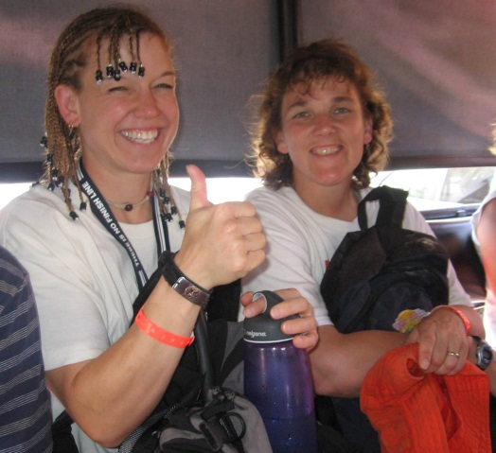
FAQs…
1. What does the CAS program require of me?
First of all, don’t panic…it isn’t that bad
Between September of Grade 11 and March of Grade 12 your CAS projects should take you somewhere in the neighbourhood of 150ish hours ~ 3 hours a week.
Meet the eight learning outcomes of CAS.
Personal reflection and recording throughout the process.
Frequent meetings with CAS advisors.
CAS fair presentation after exams in your graduating year.
Notes:
In all honesty, it is up to the CAS advisors as to whether or not your activities qualify for, and satisfy the CAS requirements – everyone will be a little different.

Slide 11
FAQs…
2. What limitations are there?
Beyond your own motivation, not many really.
Usually limitations seem to be presented by lack of organization, time management and commitment on the student’s behalf.
No politics or religion as it is not supported by the IB guidelines.
Notes:
No politics or religion……too tough for us to figure out! This will have to be addressed on a case by case basis but is not encouraged.

Slide 12
FAQs…
3. Are there any benefits to CAS?
Honestly….there are benefits!
Self discovery
Enhance students’ willingness to take risks… you can do it!
Develops the ability to communicate and make relationships.
Opens many doors that you may not have realized even existed!
Provides opportunities to experience events that may change the way you view the world around you.

Slide 13
FAQs…
4. Now what do I do?
Don’t procrastinate…bad, bad, bad!
Think about what you already do (and enjoy) that you can expand upon.
Consider what makes you uncomfortable and tackle it.
Start formulating your ‘big project’ now to give you time to effectively plan and thus reduce your stress levels.

Slide 14
Be sure to come and see us with any questions or concerns you have!

